Slide 1
Chapter 8: Deadlocks

Slide 2
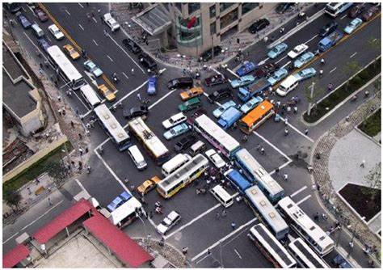
Traffic Deadlock

Slide 3
Chapter 8: Deadlocks
System model
Deadlock in Multithreaded Applications
Methods for Handling Deadlocks
Deadlock Prevention
Deadlock Avoidance
Deadlock Detection
Recovery from Deadlock

Slide 4
System Model
System consists of resources
Resource types R₁, R₂, . . ., R_{m}
    CPU cycles, memory space, I/O devices
Each resource type R_{i} has W_{i} instances.
Each process utilizes a resource as follows:
  request
  use
  release

Slide 5
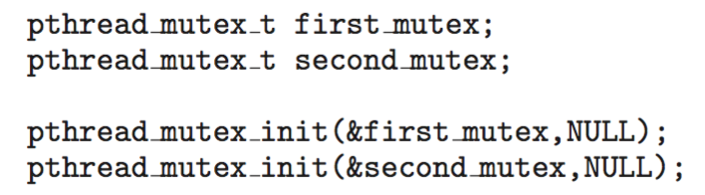
Deadlock in Multithreaded Application
Two mutex locks are created an initialized:

Slide 6
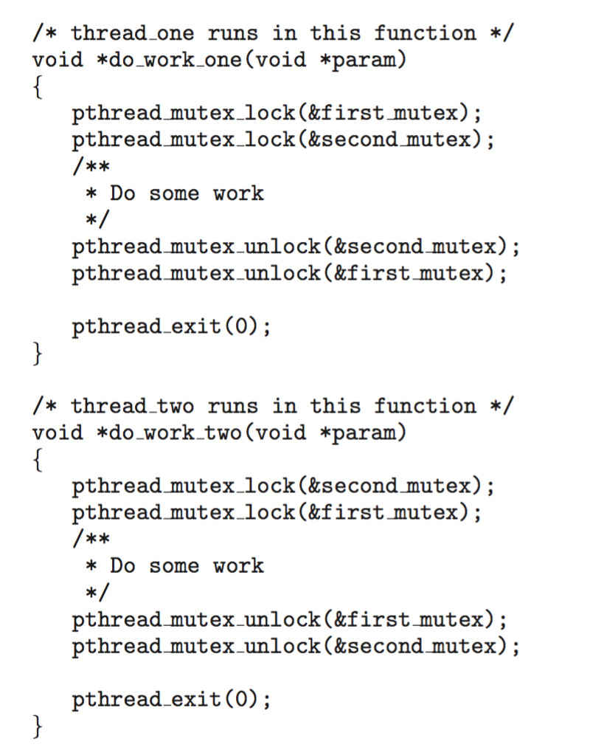
Deadlock in
Multithreaded
Application

Slide 7
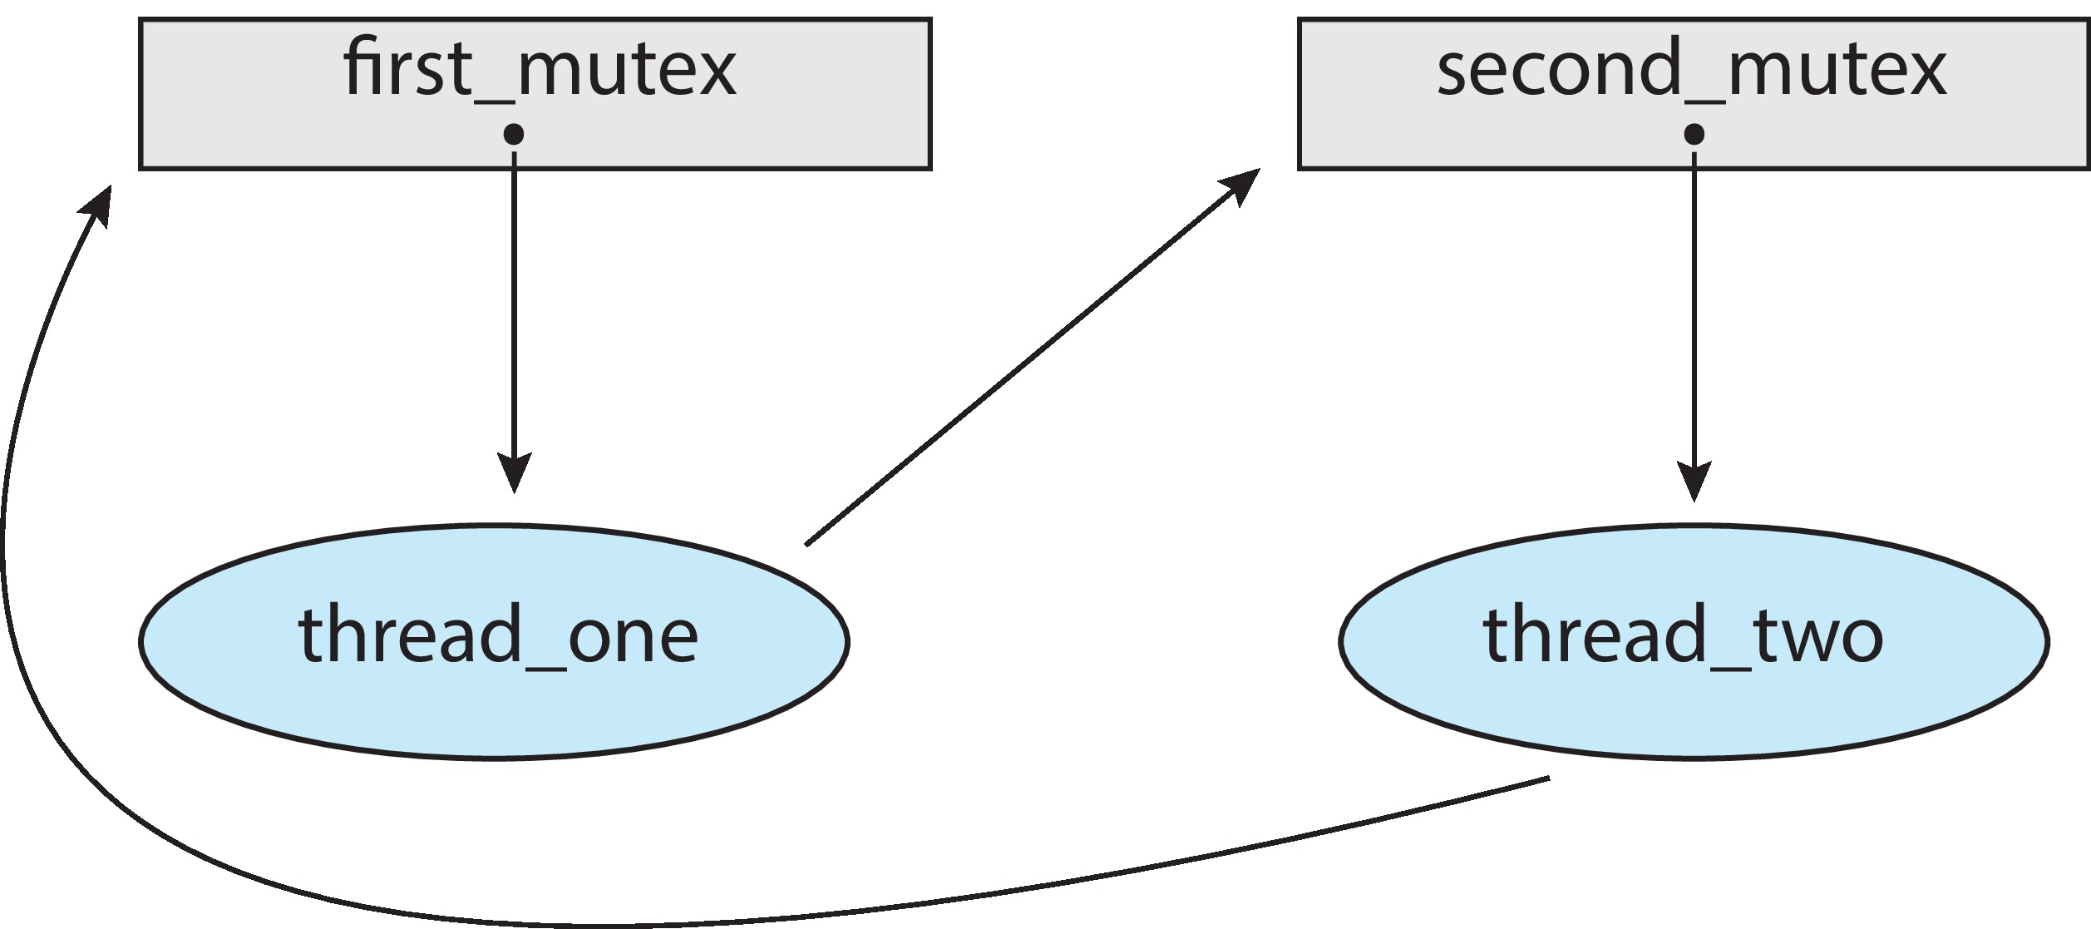
Deadlock in Multithreaded Application
Deadlock is possible if thread 1 acquires first_mutex and thread 2 acquires second_mutex. Thread 1 then waits for second_mutex and thread 2 waits for first_mutex.
Can be illustrated with a resource allocation graph:

Slide 8
Deadlock Characterization
Necessary conditions:
Mutual exclusion: only one process at a time can use a resource
Hold and wait: a process holding at least one resource is waiting to acquire additional resources held by other processes
No preemption: a resource can be released only voluntarily by the process holding it, after that process has completed its task
Circular wait: there exists a set {P₀, P₁, …, P_{n}} of waiting processes such that P₀ is waiting for a resource that is held by P₁, P₁ is waiting for a resource that is held by P₂, …, P_{n–1} is waiting for a resource that is held by P_{n}, and P_{n} is waiting for a resource that is held by P₀.

Slide 9
Resource-Allocation Graph
A set of vertices V and a set of edges E.
V is partitioned into two types:
  P = {P₁, P₂, …, P_{n}}, the set consisting of all the processes in the system
  R = {R₁, R₂, …, R_{m}}, the set consisting of all resource types in the system
request edge – directed edge P_{i} → R_{j}
assignment edge – directed edge R_{j} → P_{i}

Slide 10
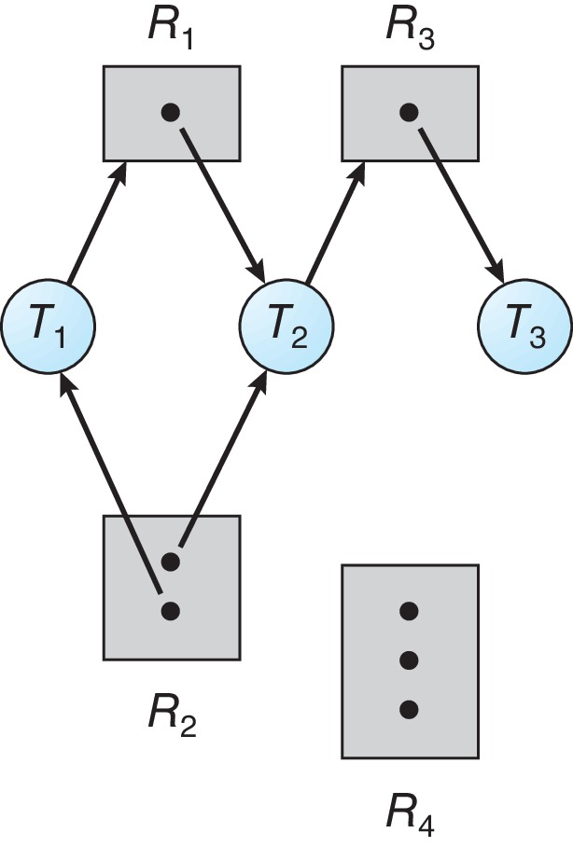
Resource Allocation Graph Example
One instance of R1
Two instances of R2
One instance of R3
Three instance of R4
T1 holds one instance of R2 and is waiting for an instance of R1
T2 holds one instance of R1, one instance of R2, and is waiting for an instance of R3
T3 is holds one instance of R3

Slide 11
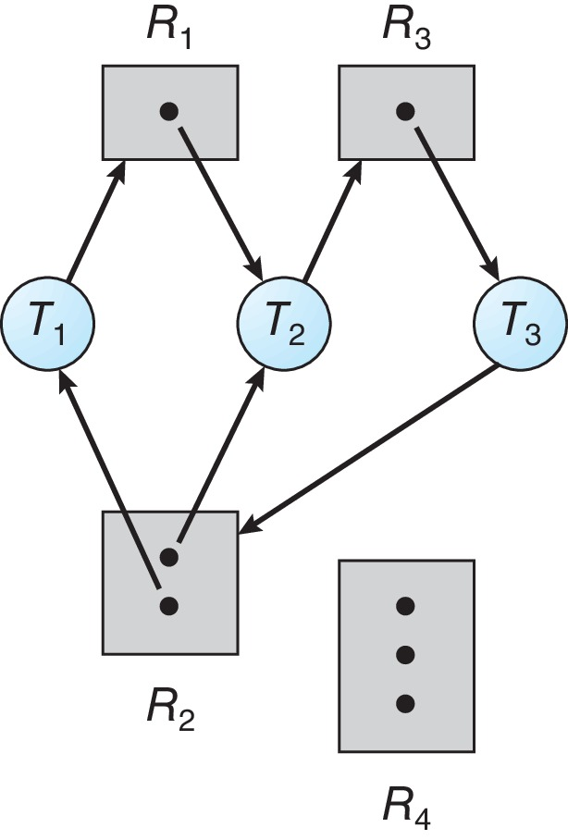
Resource Allocation Graph With A Deadlock

Slide 12

Graph With A Cycle But No Deadlock

Slide 13
Basic Facts
If graph contains no cycles ⇒ no deadlock
If graph contains a cycle ⇒
  if only one instance per resource type, then deadlock
  if several instances per resource type, possibility of deadlock

Slide 14
Methods for Handling Deadlocks
Ensure that the system will never enter a deadlock state:
  Deadlock prevention
  Deadlock avoidance
Allow the system to enter a deadlock state and then recover
Ignore the problem and pretend that deadlocks never occur in the system.

Slide 15
Deadlock Prevention
Restrain the ways request can be made, by invalidating one of the four necessary conditions
Mutual Exclusion – not required for sharable resources (e.g., read-only files); must hold for non-sharable resources
Hold and Wait – must guarantee that whenever a process requests a resource, it does not hold any other resources
  Require a process to request and be allocated all its resources before it begins execution -- impractical
  Or request resources only when the process has none allocated to it – release before making requests
  Low resource utilization; starvation possible

Slide 16
Deadlock Prevention (Cont.)
No Preemption –
  If a process that is holding some resources requests another resource that cannot be immediately allocated to it, then all resources currently being held are released
  Preempted resources are added to the list of resources for which the process is waiting
  Process will be restarted only when it can regain its old resources, as well as the new ones that it is requesting
Circular Wait – impose a total ordering of all resource types, and require that each process requests resources in an increasing order of enumeration

Slide 17
Circular Wait
Invalidating the circular wait condition is most common.
Simply assign each resource (i.e. mutex locks) a unique number.
Resources must be acquired in order.
If:
first_mutex = 1
second_mutex = 5
code for thread_two could not be
written as follows:

Slide 18
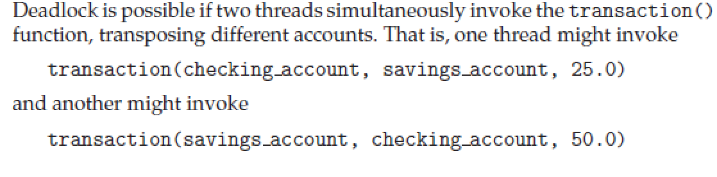
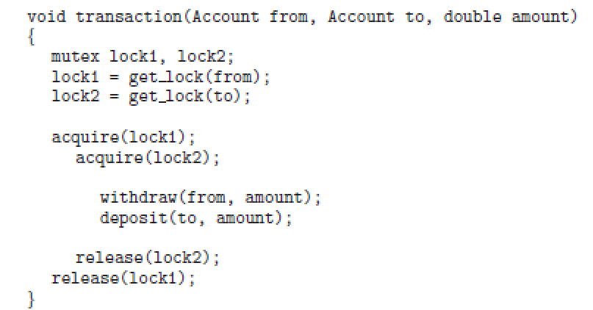
Problem with lock ordering
Lock ordering does not guarantee deadlock prevention
  locks can be acquired dynamically
E.g., a function that transfers funds between two accounts.
  each account has an associated mutex lock that is obtained from a get lock()

Slide 19
Deadlock Avoidance
Use additional a priori information
Simplest and most useful model
  each process declare the maximum number of resources of each type that it may need
Dynamically examine the resource-allocation state to ensure no circular-wait condition
Resource-allocation state is defined by
  Number of available and allocated resources,
  Max demands

Slide 20
Safe State
When a process requests an available resource, system must decide if immediate allocation leaves the system in a safe state
System is in safe state if there exists a sequence <P₁, P₂, …, P_{n}> of ALL the processes in the systems such that
  for each P_{i}, the resources that P_{i} can still request can be satisfied by currently available resources + resources held by all the P_{j}, with j < I
That is:
  If P_{i} ‘s needs cannot be met, it can wait until all P_{j} have finished
  When P_{j} is finished, P_{i} can obtain needed resources, execute, return allocated resources, and terminate
  When P_{i} terminates, P_{i +1} can obtain its needed resources, and so on

Slide 21
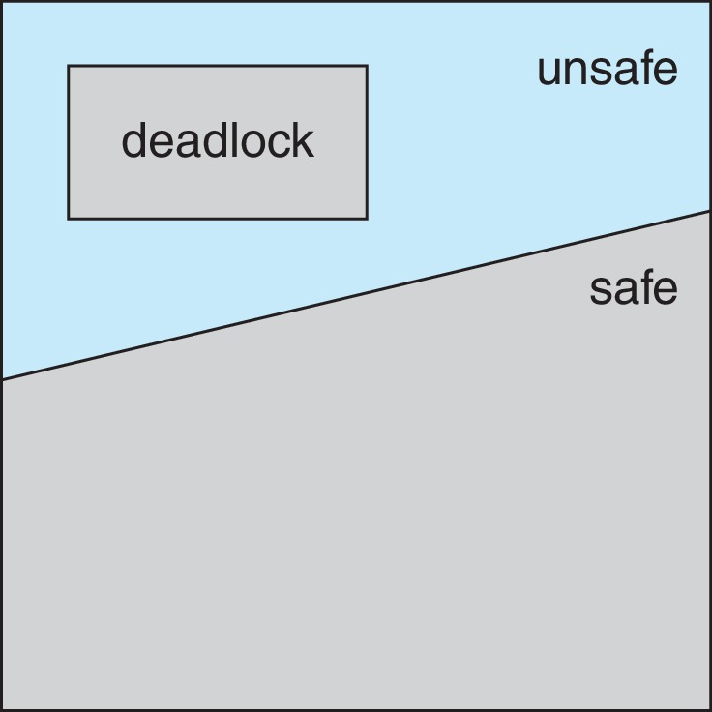
Basic Facts
If a system is in safe state ⇒ no deadlocks
If a system is in unsafe state ⇒ possibility of deadlock
Avoidance ⇒ ensure that a system will never enter an unsafe state.

Slide 22
Avoidance Algorithms
Single instance of a resource type
  Use a resource-allocation graph
Multiple instances of a resource type
  Use the Banker’s Algorithm

Slide 23
Resource-Allocation Graph Scheme
Claim edge P_{i} → R_{j} indicated that process P_{j} may request resource R_{j}; represented by a dashed line
Claim edge converts to request edge when a process requests a resource
Request edge converted to an assignment edge when the resource is allocated to the process
When a resource is released by a process, assignment edge reconverts to a claim edge
Resources must be claimed a priori in the system

Slide 24
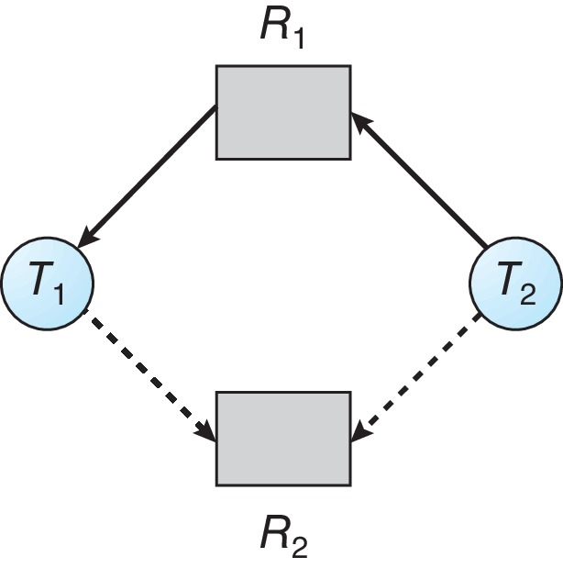
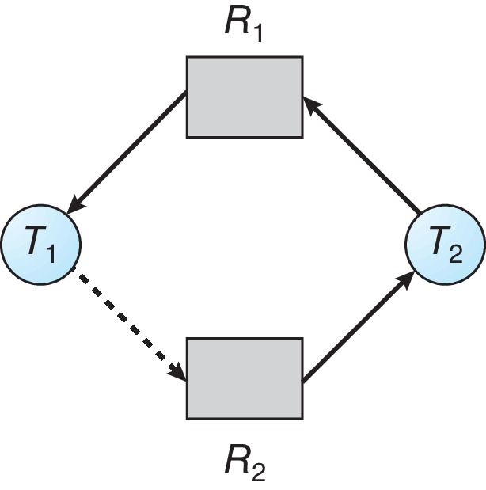
Resource-Allocation Graph
Unsafe State

Slide 25
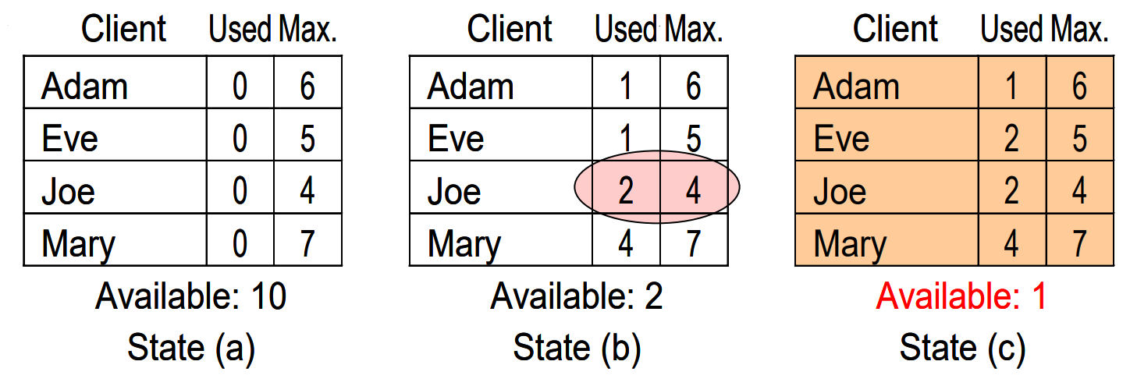
Banker’s algorithm: inspiration
Banker’s behavior (example of one resource type with many instances):
  Clients are asking for loans up-to an agreed limit
  The banker knows that not all clients need their limit simultaneously
  All clients must achieve their limits at some point of time but not necessarily simultaneously
  After fulfilling their needs, the clients will pay-back their loans
  Example: The banker knows that all 4 clients need 22 units together, but he has only total 10 units

Slide 26
Banker’s Algorithm
Multiple instances of resources
Each process must a priori claim maximum use
When a process requests a resource it may have to wait
When a process gets all its resources it must return them in a finite amount of time

Slide 27
Data Structures for the Banker’s Algorithm
Let n = number of processes, and m = number of resources types.
Available: Vector of length m. If available [j] = k, there are k instances of resource type R_{j} available
Max: n x m matrix. If Max [i,j] = k, then process P_{i} may request at most k instances of resource type R_{j}
Allocation: n x m matrix. If Allocation[i,j] = k then P_{i} is currently allocated k instances of R_{j}
Need: n x m matrix. If Need[i,j] = k, then P_{i} may need k more instances of R_{j} to complete its task
    Need [i,j] = Max[i,j] – Allocation [i,j]

Slide 28
Safety Algorithm
1. Let Work and Finish be vectors of length m and n, respectively. Initialize:
      Work = Available
      Finish [i] = false for i = 0, 1, …, n- 1
2. Find an i such that both: //find an unfinished thread i to run
  (a) Finish [i] = false
  (b) Need_{i} ≤ Work
  If no such i exists, go to step 4
3. Work = Work + Allocation_{i} : //return i’s resources once finished
Finish[i] = true
go to step 2
4. If Finish [i] == true for all i, then the system is in a safe state

Slide 29
Resource-Request Algorithm for Process P_{i}
Request_{i} = request vector for process P_{i}. If Request_{i} [j] = k then process P_{i} wants k instances of resource type R_{j}
  1. If Request_{i} ≤ Need_{i} go to step 2. Otherwise, raise error condition, since process has exceeded its maximum claim
  2. If Request_{i} ≤ Available, go to step 3. Otherwise P_{i} must wait, since resources are not available
  3. Pretend to allocate requested resources to P_{i} by modifying the state as follows:
      Available = Available – Request_{i};
      Allocation_{i} = Allocation_{i} + Request_{i};
      Need_{i} = Need_{i} – Request_{i};
    If safe ⇒ the resources are allocated to P_{i}
    If unsafe ⇒ P_{i} must wait, and the old resource-allocation state is restored

Slide 30
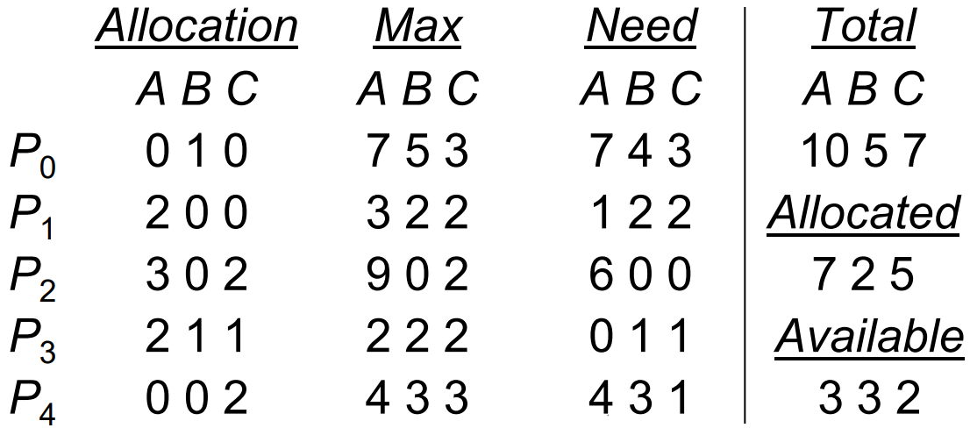
Example of Banker’s Algorithm
5 processes P₀ through P₄; 3 resource types:
A (10 instances), B (5 instances), and C (7 instances)
Snapshot at time T₀:
The system is in a safe state for sequence < P₁, P₃, P₄, P₂, P₀>
  P₁ -> （5，3，2），P₃ -> （7，4，3）， P₄ -> （7，4，5），P₂ -> （10，4，7）…
Alternative safe sequences: < P₁, P₃, P₀, P₄, P₂>

Slide 31
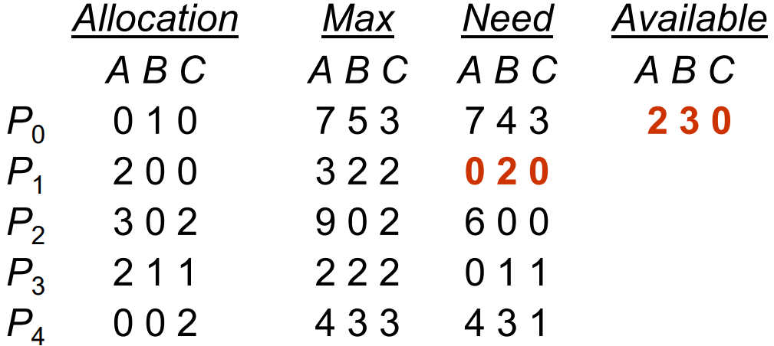
Example: P₁ Request (1,0,2)
Check that Request ≤ Available (that is, (1,0,2) ≤ (3,3,2) ⇒ true
Executing safety algorithm shows that sequence < P₁, P₃, P₄, P₀, P₂> satisfies safety requirement
Can request for (3,3,0) by P₄ be granted?
Can request for (0,2,0) by P₀ be granted?

Slide 32
Deadlock Detection
Allow system to enter deadlock state
Detection algorithm
Recovery scheme

Slide 33
Single Instance of Each Resource Type
Maintain wait-for graph
  Nodes are processes
  P_{i} → P_{j} if P_{i} is waiting for P_{j}
Periodically invoke an algorithm that searches for a cycle in the graph. If there is a cycle, there exists a deadlock
An algorithm to detect a cycle in a graph requires an order of n² operations, where n is the number of vertices in the graph
The BCC toolkit a tool that can detect potential deadlocks with Pthreads mutex locks in a user process
  Operates by inserting probes which trace calls to the pthread mutex lock() and pthread mutex unlock() functions.
  When the specified process makes a call to either function, deadlock detector constructs a wait-for graph of mutex locks in that process
  Reports possible deadlock when detecting a cycle

Slide 34
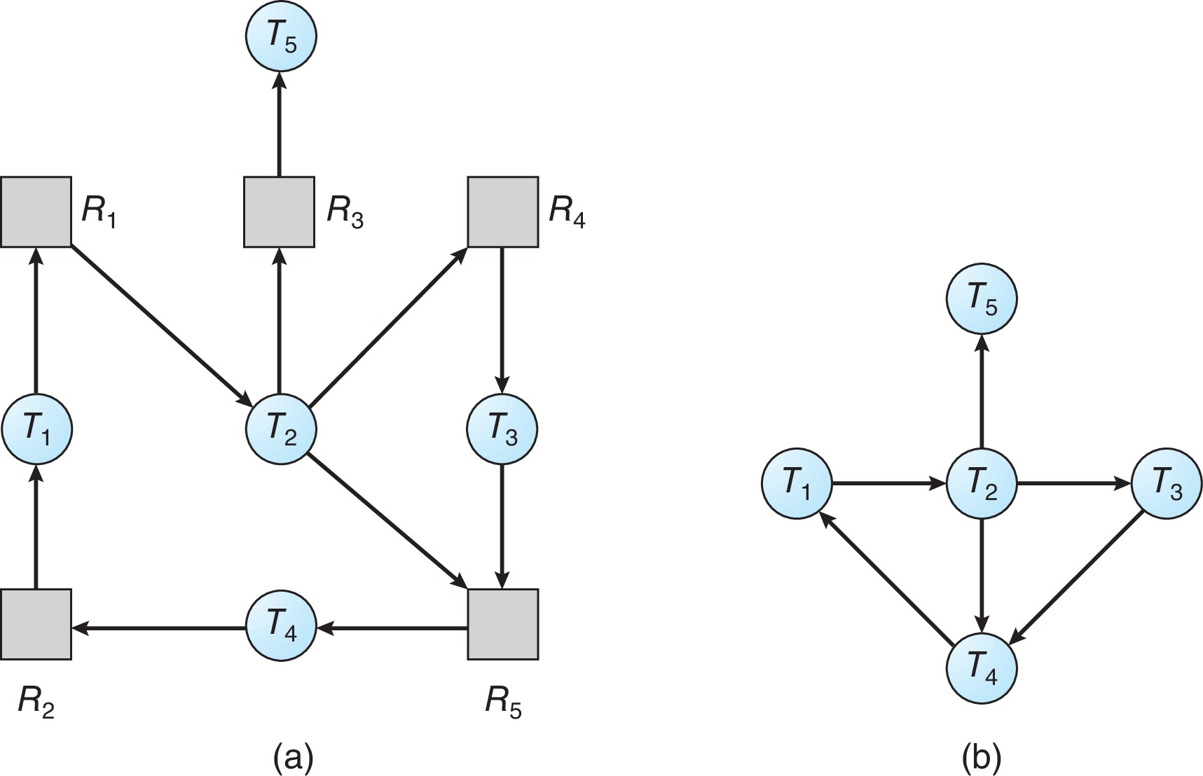
Resource-Allocation Graph and Wait-for Graph
Resource-Allocation Graph
Corresponding wait-for graph

Slide 35
Several Instances of a Resource Type
Available: A vector of length m indicates the number of available resources of each type
Allocation: An n x m matrix defines the number of resources of each type currently allocated to each process
Request: An n x m matrix indicates the current request of each process. If Request [i][j] = k, then process P_{i} is requesting k more instances of resource type R_{j}.

Slide 36
Detection Algorithm
1. Let Work and Finish be vectors of length m and n, respectively Initialize:
  (a) Work = Available
  (b) For i = 1,2, …, n, if Allocation_{i} ≠ 0, then
  Finish[i] = false; otherwise, Finish[i] = true
2. Find an index i such that both:
  (a) Finish[i] == false
  (b) Request_{i} ≤ Work
  If no such i exists, go to step 4

Slide 37
Detection Algorithm (Cont.)
3. Work = Work + Allocation_{i}
Finish[i] = true
go to step 2
4. If Finish[i] == false, for some i, 1 ≤ i ≤ n, then the system is in deadlock state. Moreover, if Finish[i] == false, then P_{i} is deadlocked

Slide 38
Example of Detection Algorithm
Five processes P₀ through P₄; three resource types
A (7 instances), B (2 instances), and C (6 instances)
Snapshot at time T₀:
Allocation Request Available
A B C A B C A B C
P₀ 0 1 0 0 0 0 0 0 0
P₁ 2 0 0 2 0 2
P₂ 3 0 3 0 0 0
P₃ 2 1 1 1 0 0
P₄ 0 0 2 0 0 2
Sequence <P₀, P₂, P₃, P₁, P₄> will result in Finish[i] = true for all i

Slide 39
Example (Cont.)
P₂ requests an additional instance of type C
Allocation Request Available
A B C A B C A B C
P₀ 0 1 0 0 0 0 0 0 0
P₁ 2 0 0 2 0 2
P₂ 3 0 3 0 0 1
P₃ 2 1 1 1 0 0
P₄ 0 0 2 0 0 2
State of system?
  Can reclaim resources held by process P₀, but insufficient resources to fulfill other processes; requests
  Deadlock exists, consisting of processes P₁, P₂, P₃, and P₄

Slide 40
Detection-Algorithm Usage
When, and how often, to invoke depends on:
  How often a deadlock is likely to occur?
  How many processes will need to be rolled back?
    one for each disjoint cycle
If detection algorithm is invoked arbitrarily, there may be many cycles in the resource graph and so we would not be able to tell which of the many deadlocked processes “caused” the deadlock.

Slide 41
Recovery from Deadlock: Process Termination
Abort all deadlocked processes
Abort one process at a time until the deadlock cycle is eliminated
In which order should we choose to abort?
  Priority of the process
  How long process has computed, and how much longer to completion
  …

Slide 42
Recovery from Deadlock: Resource Preemption
Selecting a victim – minimize cost
Rollback – return to some safe state, restart process for that state
Starvation – same process may always be picked as victim, include number of rollback in cost factor

Slide 43
Homework
Programming Projects: Banker’s Algorithm

Slide 44
End of Chapter 8

